Slide 1
VERSION CONTROL

Slide 2
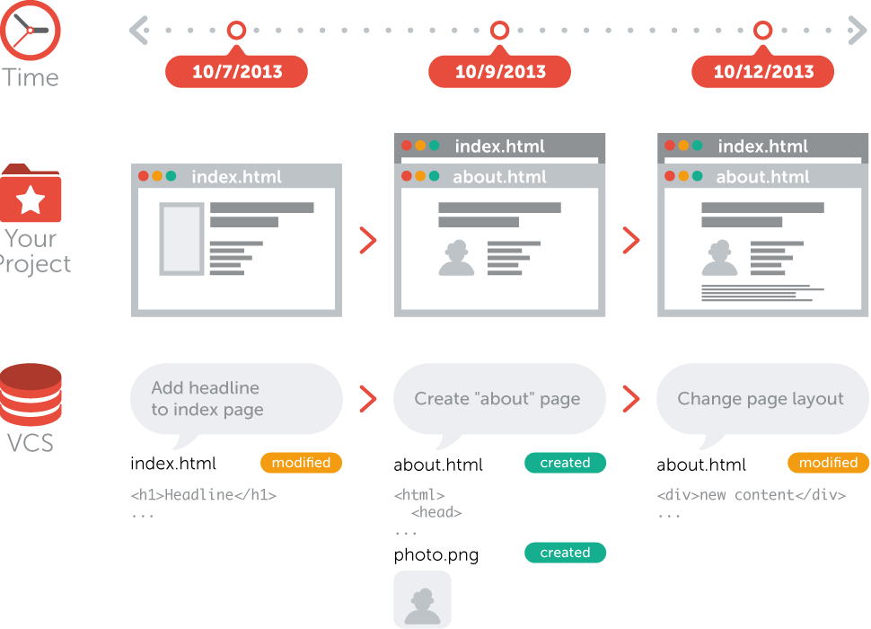
WHAT IS VERSION CONROL
Version control allows collaborators to keep track of changes in a project
Theses changes may include the creation of new files or changes made to a file
Files can be of any type or format such as: html, JavaScript, Java, Word, Excel, text etc.

Slide 3
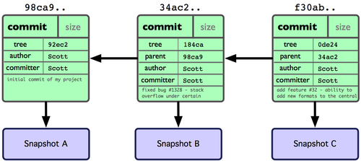
WHAT IT DOES
Keeps track of code history
Takes “snapshots” of files a.k.a. “commits”
You have the ability to comeback to any snapshot at any time

Slide 4
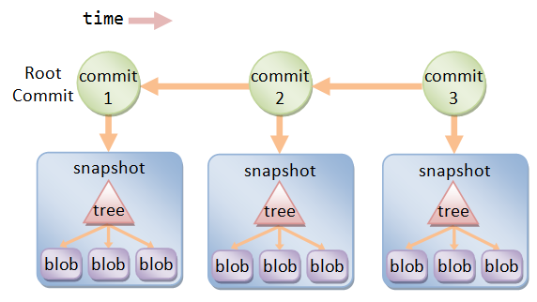
COMMIT GRAPH
Commits can be represented as a graph

Slide 5
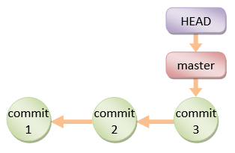
HEAD
HEAD refers to the latest commit

Slide 6
Referances
What is Version Control? (n.d.). Retrieved July 7, 2018, from https://www.git- tower.com/learn/git/videos/what-is-version-control
T. (2017, February 05). Git & GitHub Crash Course For Beginners. Retrieved January 7, 2018, from https://www.youtube.com/watch?v=SWYqp7iY_Tc
How to get started with GIT and work with GIT Remote Repo. (n.d.). Retrieved January 7, 2018, from https://www.ntu.edu.sg/home/ehchua/programming/howto/Git_HowTo.html

